Slide 1

Team “Victoria Peak”
Team members:
Emilyan Georgiev
Tihomir Todorov
Hristyan Mishinkov
Veselin Hitrov
Georgi Genkov
Stoyan Petrov

Slide 2
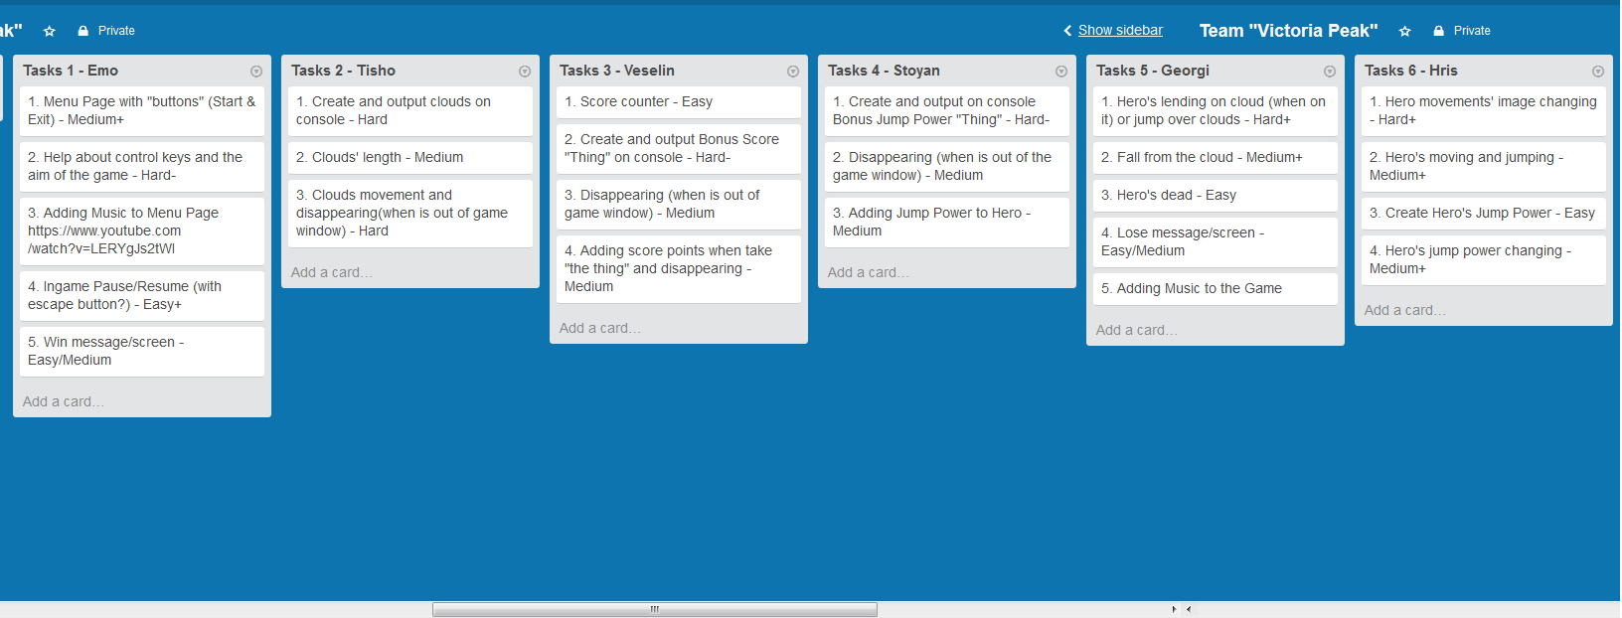
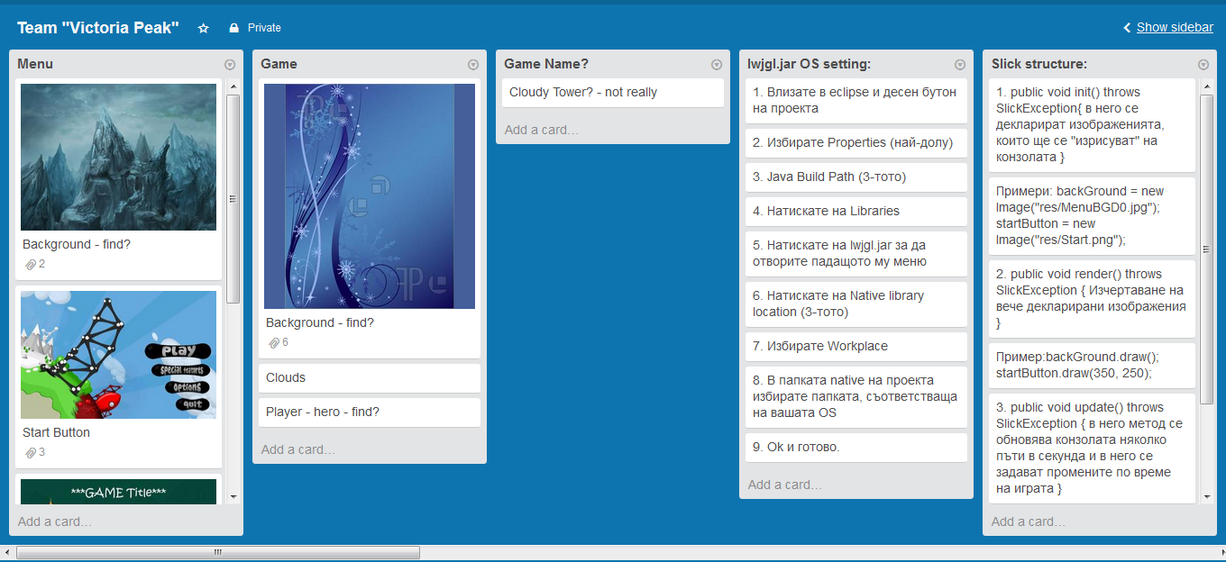
Trello

Slide 3
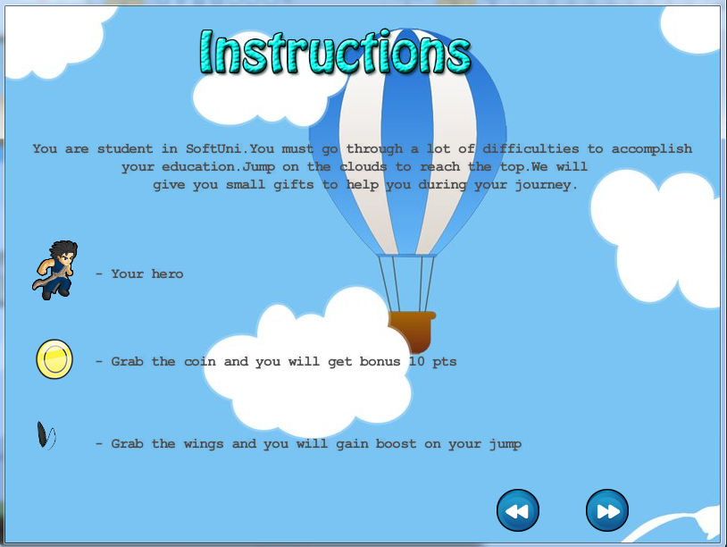
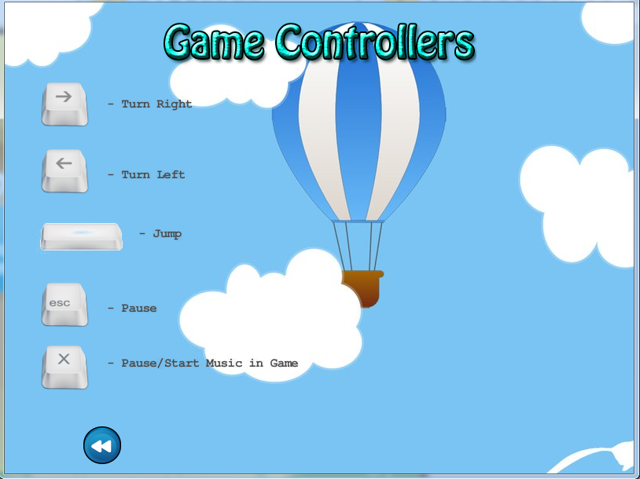

Menu and Help

Slide 4
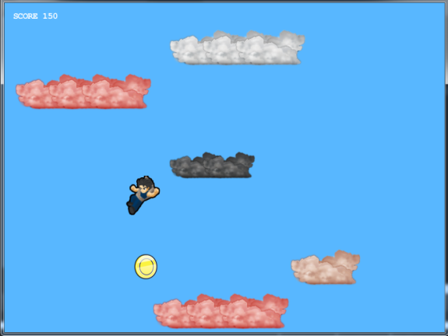
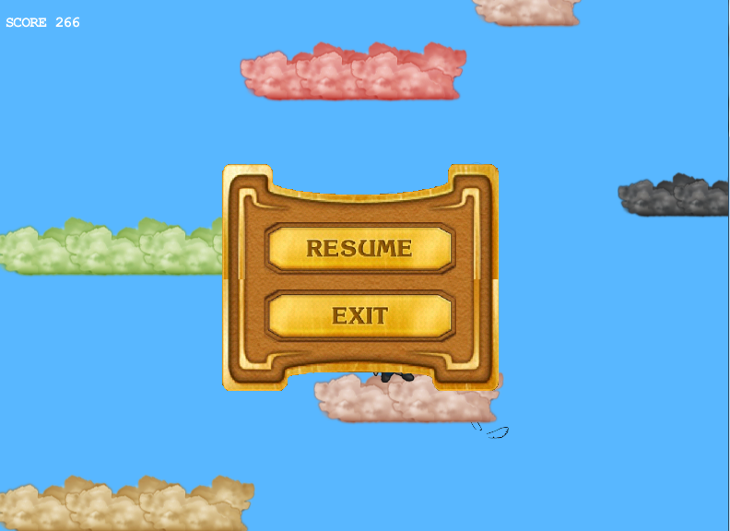
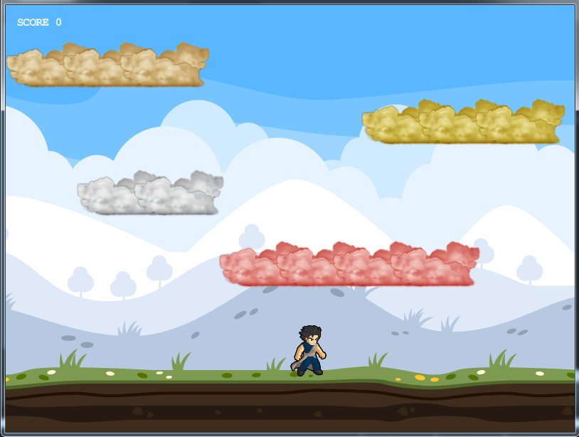
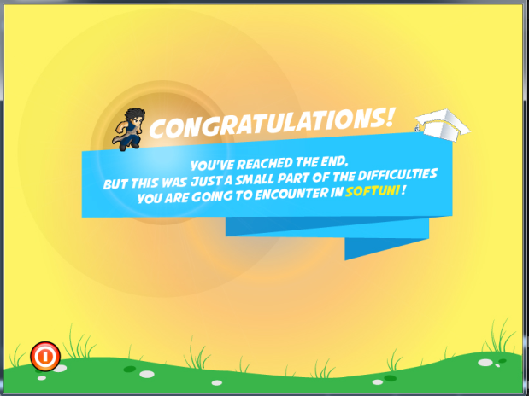

Gameplay

